Slide 1
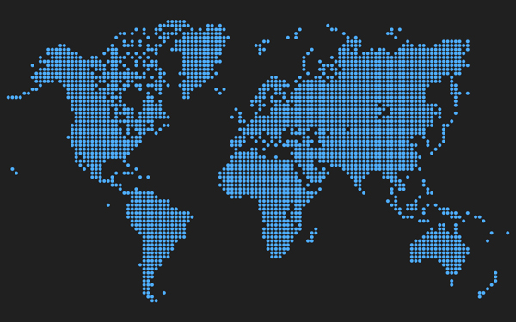
EXECUTIVE SUMMARY
Global Media & Technology Intellicast Series
Essential Strategic Intelligence for Today’s Media Ecosystem
Global Advertising & Marketing Forecast 2015-19
3rd Edition
Report #1 of 3 in Series
Comprehensive Data & Analytics by Country, Silo, Media Sector, Platform & Channel
Country, Platform, Channel
4 Global Regions
15 Leading Countries
2 Major Sectors
15 Media Silos (New in 2015)
10 Digital & Alternative Platforms
39 Digital & Alternative Channels
11 Traditional Media Platforms
Definitions by Sector, Platform, Channel
Rankings by Region, Country, Platform, Channel
2009-14 Actuals
2015-19 Forecasts
15 Leading Markets
Australia
Brazil
Canada
China
France
Germany
India
Italy
Japan
Mexico
Russia
South Korea
Spain
United Kingdom
United States
PQ Media on LinkedIn
www.pqmedia.com
PQ Media on Twitter

Slide 2
Total Global Advertising & Marketing Revenues Rose 4.5% in 2014 to $1.03 Trillion Projected to Post 6% CAGR to $1.37 Trillion in 2019

Slide 3
Advertising Accounted for 50.2% of Overall Advertising & Marketing in 2014
Digital & Alternative Media Represented 28% of Advertising & Marketing in 2014
Share of Advertising vs. Marketing in 2014
Share of Advertising & Marketing by Sector in 2014
Advertising
Digital & Alternative
Marketing
Traditional

Slide 4
Direct Marketing is the Largest of the 15 Global Media Silos at $217.3 Billion in 2014
Entertainment Advertising, such as Ads in Videogames, is Smallest at $8.5 Billion
Revenues of Advertising & Marketing Media Silos in 2014
Internet & Mobile Advertising and Internet & Mobile Marketing are specific channels that are exclusively digital, such as online search and mobile marketing apps
The digital brand extension of traditional media companies, such as ads placed on ESPN.com & ESPN Mobile, are included in the traditional media platform (e.g., Pay TV).
Additionally, all forms of the media platform, including pure-play digital companies are included in that platform, such as Huffington Post in Newspapers

Slide 5
Global Advertising & Marketing Will Mirror Nominal GDP Growth, Slight Spikes in Even Years
Digital & Alternative Media to Outpace Economy, Traditional Media to Underperform GDP

Slide 6
US Generates Highest Advertising & Marketing Revenues in 2014
Brazil Fastest Growth Market, UK Registers Highest Share of Digital & Alternative Media
Overall Advertising & Marketing
2014 Revenues | 2014 vs. 2013 Growth | 2014 Share of D&A Media
United States | Brazil | United Kingdom
Japan | India | Australia
China | Mexico | Canada
United Kingdom | China | South Korea
Germany | United Kingdom | China
Source: PQ Media
US ranked 6th in growth and 7th in share of digital & alternative media

