Slide 1
MOBILE APPS
FOR SMART RESTAURANTS
We power your restaurant's growth engine with app fuel.
presented by

Slide 2
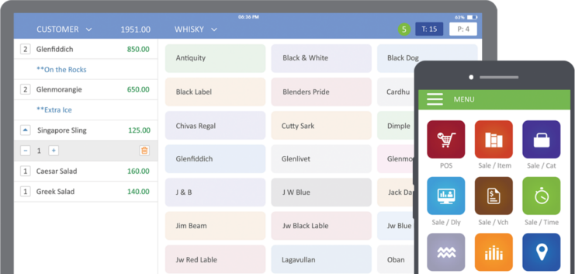
RanceLab® FusionMobi
is a collection of coolest mobile apps for restaurants.
With FusionMobi, important information and essential features are always at your fingertips.
presented by
RanceLab®

Slide 3
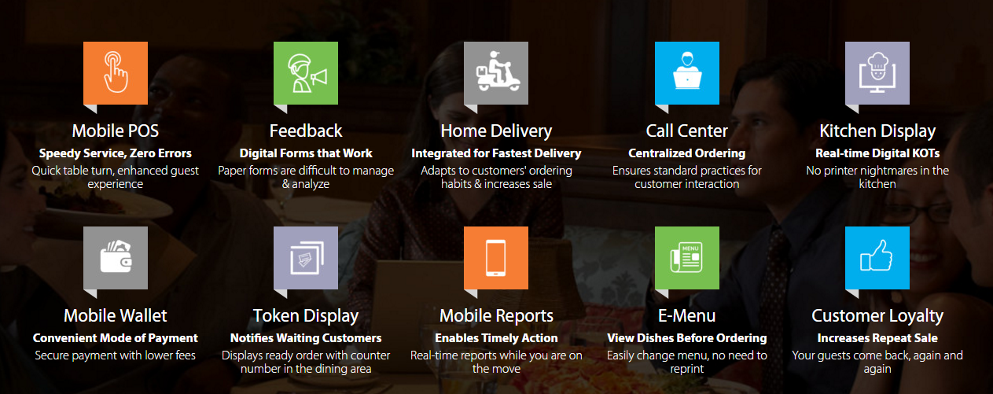
FEATURES TO PUT RESTAURANT BUSINESS ON TURBO MODE
presented by
RanceLab®

Slide 4
Thanks
Let’s Talk Today
presented by
RanceLab®

