Slide 1
12 things your business website should be doing to dominate Google and get phone calls
Free SEO Training by SEO Specialist Romeo Man and James Mathison
1616947221
romeo@man.digital
http://man.digital

Slide 2
1. Is your website mobile friendly?
Google prefers sites that pass their mobile-friendly test since it provides a better overall experience for their search engine users.
Check it here:
https://www.google.com/webmasters/tools/mobile-friendly/
Run the test on your own website and see if you pass or fail this test.

Slide 3
2. Does your site load quickly?
Google prefers faster loading sites for the same reason as the previous slide. Slow website loading speeds upset Google search engine users.
Check your load speeds here:
https://developers.google.com/speed/pagespeed/insights
Google works on a traffic light system, let’s hope your scores will be green.

Slide 4
3. Are you listed in the top 100 local business directories like yelp, yell and merchant circle?
Google loves websites that are listed in many of the top local business directories. The reasons are two-fold.
Firstly, a business that has taken the time to list themselves appears like a business that will be around for the long-haul.
Secondly, these directories can send traffic to your site and Google looks at referral traffic when determining rankings.

Slide 5
4. Are you setup on Google+, Facebook, Twitter, LinkedIn & YouTube.
Google loves websites that are listed in these top social networking sites. Again, The reasons are two-fold.
Firstly, a business that has taken the time to list themselves appears to be more brand aware and Google LOVES brands.
Secondly, these social platforms can send traffic to your site as already mentioned Google looks at referral traffic when determining rankings.
An added benefit of being listed on these social networking sites is that it makes your business MUCH easier to be shared and recommended amongst your customers and their friends.

Slide 6
5. Are you aware of what your competition are doing to rank online?
Knowing what your competition is doing online, the money they are spending, the keywords they are targeting, the amount of effort they are taking can be tracked with online tools.
http://semrush.com will give you great insights into your competition and it’s a great way to see what search terms are sending them their customers.
Head over to SEM Rush now and compare your website to the sites of those you consider your competition. Take the business websites of the companies you want to be like and analyse them. Who is crushing it in your market?

Slide 7
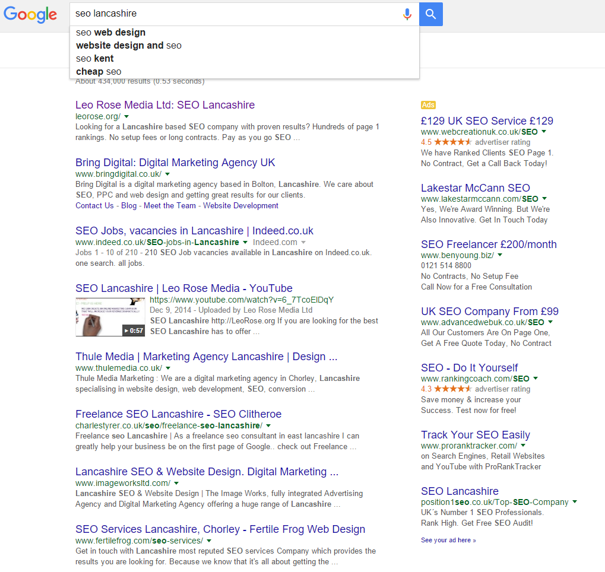
6. Is your website optimised properly?
Figure out the keyword’s (words people search for) you would like to show up for in Google.
Head to Google and do a search for those keywords and look at the top 10 positions.
The blue text above a listing is called the “Title Tag” count how many of the top 10 have the keyword you just searched in the title tag.
Check your website now, do you have your keywords in the title tag?
There are a number of these “Onpage SEO” factors that Google loves websites to have, the title tag is considered one of the most important. Read up on heading tags, meta tags and keyword density for additional help.

Slide 8
7. Is your contact information easily found?
Is your telephone number in a prominent position on the page? People do not like searching or scrolling to find ways to get in contact.
Make sure your telephone number is clearly visible at the top of the page, that it is in a font-size that is easy to read and a colour that makes it stand out in an obvious way.
Make sure you have a contact us page with your company name, address, telephone number and links to your social networking sites.

Slide 9
8. Do you have a video embedded on your website?
Visitors watch videos – FACT!
Having a video on your website will keep your visitors on your pages for longer.
Google uses length of time on page to work out how good your website is compared to others.
Having a demo of a product, a welcome message from the owner or an “explainer” style video of your services will keep people from leaving too quickly.

Slide 10
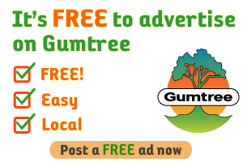
9. Are you listed on Free Ad sites?
Sites such as Gumtree and Freeads have lots of visitors that are searching for local service providers, be sure to list your services on those sites.
The traffic these sites can send is very beneficial in terms of new business and referral traffic, which we know Google loves.

Slide 11
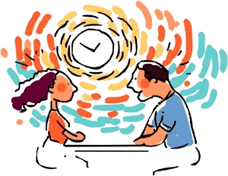
10. Do you have an “About Us” page?
Introduce your business properly to your visitors with a well written page that builds rapport and will hopefully convert the visitor into a paying customer.
Think of your about us page as “speed-dating” with your visitors. You only have a few moments to win them over and turn them from a browser and into someone that wants to utilise your services.

Slide 12
11. Are you showing testimonials on your website?
Think back to the last time you bought a pair of shoes, or researched the next book you wanted to read. Where did your search start? If you’re like any other consumer, it probably began with customer reviews.
Having testimonials and/or reviews on your website will improve your businesses chances of making a sale and will also keep visitors on your website for longer, as they read or watch them.
Remember, having visitors stick around longer helps because time spent on your website is a Google ranking factor.

Slide 13
12. Do other websites link to yours?
This is really, really important, when it comes to SEO.
If another website links to your website it is the equivalent of receiving a thumbs up vote.
Google likes websites with links because the link building side of SEO is considered a popularity contest.
Not all links are considered equal, some are considered helpful while others are considered damaging.
Use http://ahrefs.com to check your link profile. Do you have a lot of links, hardly any or none at all? Top tip: Check out your competitors link profiles to see where their links are coming from. Building links on the same types of websites that they have links from is advantageous for your rankings.

Slide 14
Summary
You need a site that:
Is mobile friendly
Loads quickly
Is listed in Local directories
Is listed on the top social networking sites
Is optimised correctly
Has an embedded video
Is listed on the top free ad sites
Has clear contact information
Has an about page
Is showing testimonials
Has great backlinks

Slide 15
Need help?
If you have noticed your website hasn’t made the grade based on the previous slides, don’t worry.
We can help you fix any or all of these issues, unless you want to do it yourself of course ☺
Ranking clients on the first page of Google using the methods listed above is tried and tested.
If you would like us to help you, send me an email to romeo@man.digital
Alternatively you can visit my website http://man.digital

Slide 16
Why trust us?
We have over 6 years online sales experience.
We have a lot of happy client testimonials
We stay up to date on all the latest Google algorithm changes
We invest heavily in our own online marketing training to ensure we stay ahead of the curve.
We just rank!

Slide 17
Get In Touch!
Manchester, UK | Krakow, PL
1616947221
http://man.digital
Romeo@man.digital
https://www.facebook.com/manndigital

