Slide 1
The Benefits of Microwave Ablation
Presented by: Symple Surgical Inc.

Slide 2
The Benefits of Microwave Ablation
The goal of this session is to:
Introduce the concept of Microwave Ablation
Basic Physics of Microwave and other Radio Frequency Energy Sources
Review some of the therapies & fields Microwave Ablation is being used in
Many of which have FDA approval
Compare the capabilities Microwave Ablation to more widely accepted RF Ablation

Slide 3
What is Microwave Ablation?
Microwave Energy is a subset of the Radio Frequency Spectrum, similar to RF Ablation Energy
Transmitted via insulated coaxial cable
Delivered through an antenna/emitter
Common Medical Microwave: ƒ = 915 MHz, 2.45 MHz
For reference: RF: ƒ = 460 kHz
Creates an electromagnetic-field for dielectric heating
RF Ablation requires conduction of alternating electrical current

Slide 4
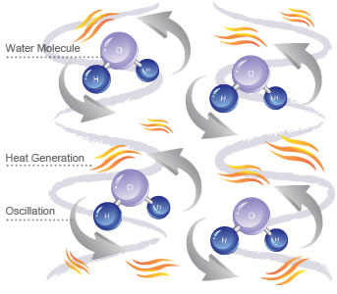
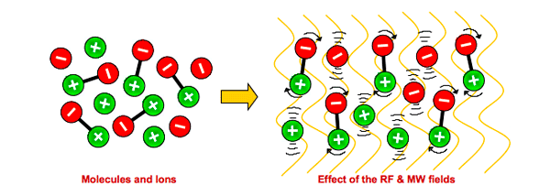
What is Microwave Ablation?
Dielectric Heating occurs when the molecules, as part of human tissue, become polarized by an alternating electromagnetic field. Rapid rotational movement, referred to as molecular dipole rotation, of the molecules inside the material cause collisions with neighboring molecules. The ensuing result is frictional heat.
The heating zone is controlled by several factors including: Power, Frequency, Antenna Design, and the material properties in the near-field of the antenna.

Slide 5
Common Applications for Microwave Ablation
Microwave Ablation is a relatively new therapy used primarily in the field of Oncology. Current Microwave Ablation therapies include:
Tumor Ablation
Renal
Adrenal
Liver
Lung
Kidney
Prostate
Soft Tissue Ablation
Amenorrhea
Bone Metastases
Heart Arrhythmias
Cosmetic Treatments

Slide 6
Microwave Ablation Companies
Currently, there are only a few companies with developed products in the field of Microwave Ablation:
BSD Medical
NeuWave Medical
MedWaves
Microsulis Medical (AngioDynamics)
ValleyLab Covidien
Miramar Labs
Vision Medical
ProstaLund
Symple Surgical Inc.
“Due to its high success rate in treatment of most cancers, the microwave ablation market is estimated to rise very quickly by 2020.”
- Markets and Markets Research Report, Ablation Devices Market to 2016

Slide 7
Advantages of Microwave Ablation
Microwave Ablation has several advantages for treatment compared to more common ablation therapies including:
Faster Heating¹
Larger Heating Zone²
More Uniform Heating Zone³
Less dependent on Tissue Properties³
No grounding pad or 2nd pole necessary
Tissue contact is not necessary
Independent of wall pressure

Slide 8
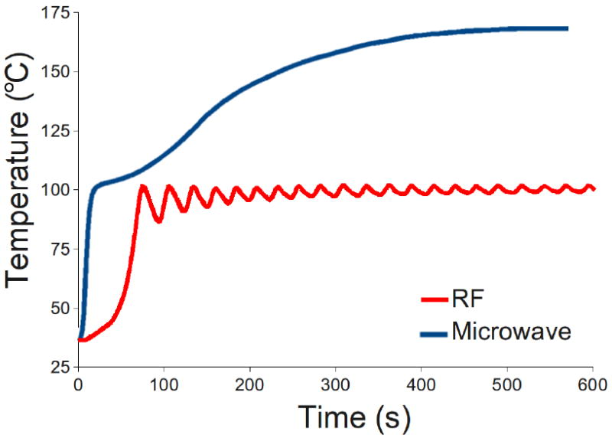
Microwave Ablation vs. RF Ablation
Figure 1: Temperature measurement taken in vivo Swine Kidney, 5mm from applicator. ¹
Faster Heating

Slide 9
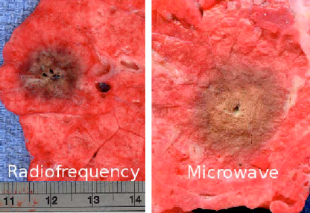
Microwave Ablation vs. RF Ablation
Figure 2: Typical RF (left, 1 cm diameter) and Microwave (right, 2.1 cm diameter) ablations created at a power of about 40 W for 10 min in ex vivo porcine lung. ²
Larger Heating Zone

Slide 10
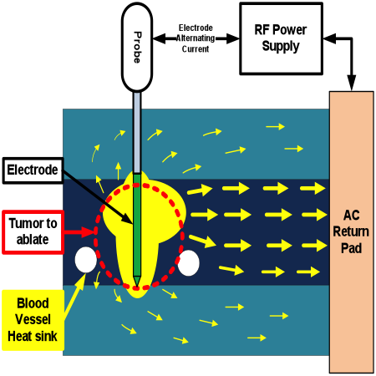
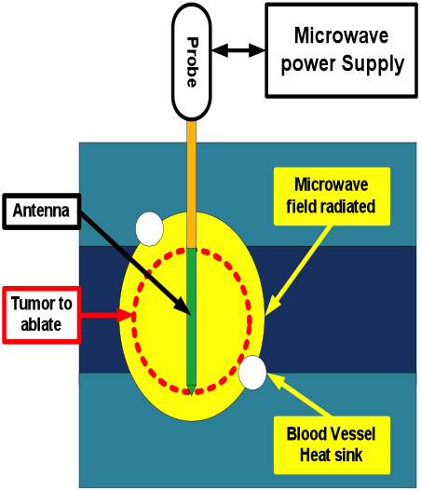
Microwave Ablation vs. RF Ablation
More Uniform Heating

Slide 11
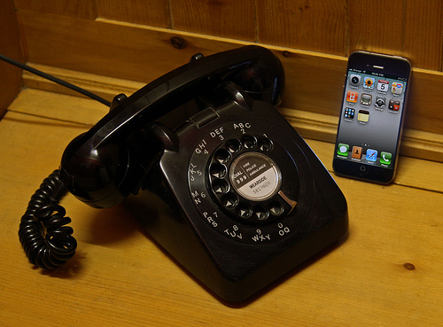
Microwave Ablation: New Technology has distinct Advantages

Slide 12
Citations
Brace CL. Radiofrequency and microwave ablation of the liver, lung, kidney and bone: what are the differences. Curr Probl Diagn Radiol. 2009 May-Jun; 38(3): 135-143.
Andreano A, Huang Y, Meloni Mf, Lee F, Brace C. Microwaves create larger ablations than radiofrequency when controlled for power in ex vivo tissue. Medical Physics. 2010 Jun; 37(6): 2967-2973.
Laeseke P, Sampson L, Frey T, van der Weide D, Lee F, Brace C. Thermal ablation in kidneys: microwave ablation with a triaxial antenna results in larger zones of coagulation than rf. Radiological Society of North America Annual Meeting; Chicago, IL. 2006
Lubner M, Brace C, Hinshaw JL, Lee F. Microwave Tumor Ablation: Mechanism of Action, Clinical Results and Devices. Journal of Vascular Interventional Radiology. 2010 Aug; 21(8 Suppl): S192-S203.

