Slide 1
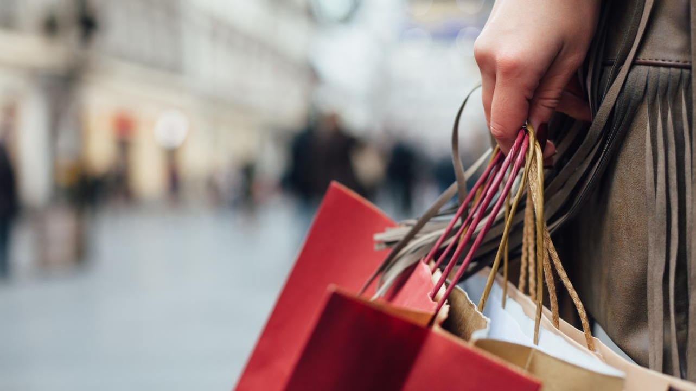

PHYGITAL RETAIL Merging Online and In Store Customer Experience

Slide 2


Presenters
Sunil Bajaj
Director & Unit Head Retail & CPG Practice
Email: sunil.bajaj@aspiresys.com
Kamal chandramohan
Practice Head – Mobility
Email: kamal.chandramohan@aspiresys.com

Slide 3

If you have any questions, please type them in the question tab located at the bottom
We will provide answers during the Q&A session towards the end of the webinar
In case if you do not receive answers to your question today, you will certainly receive answers via email shortly
Thanks for your participation and enjoy the session

Slide 4
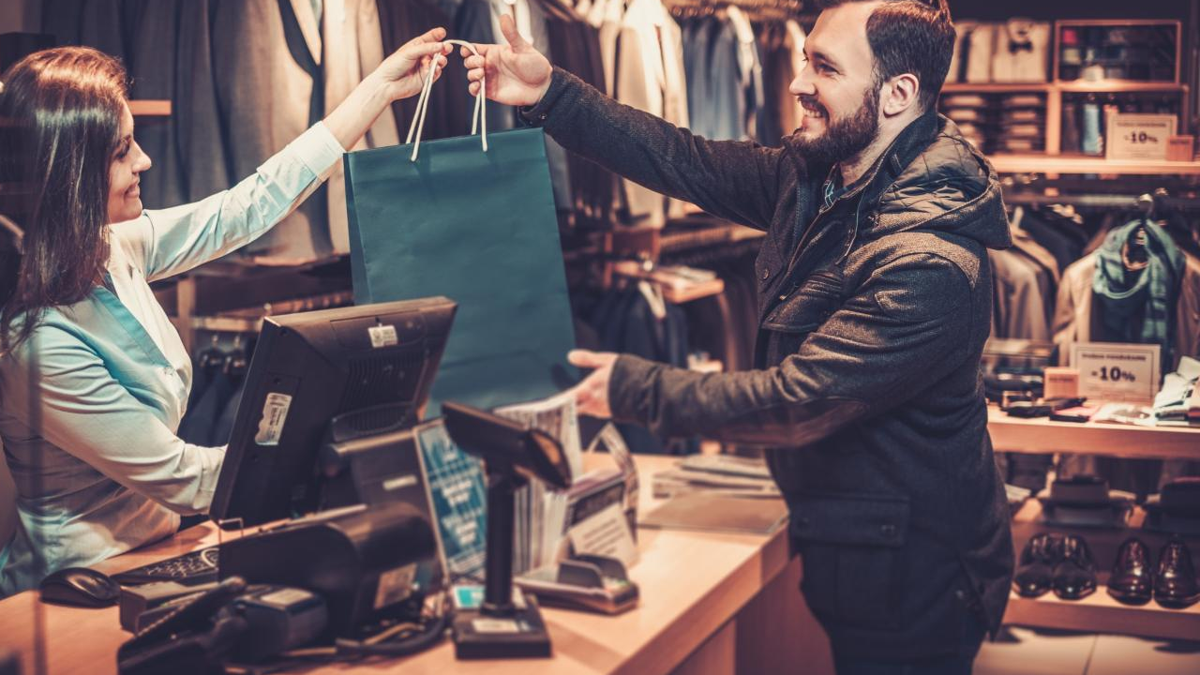
Agenda
The Digital Retail Journey
Trends shaping tomorrow’s Retail
Current Omnichannel Experience & Challenges
One Solution to help achieve Phygital Goals

Slide 5
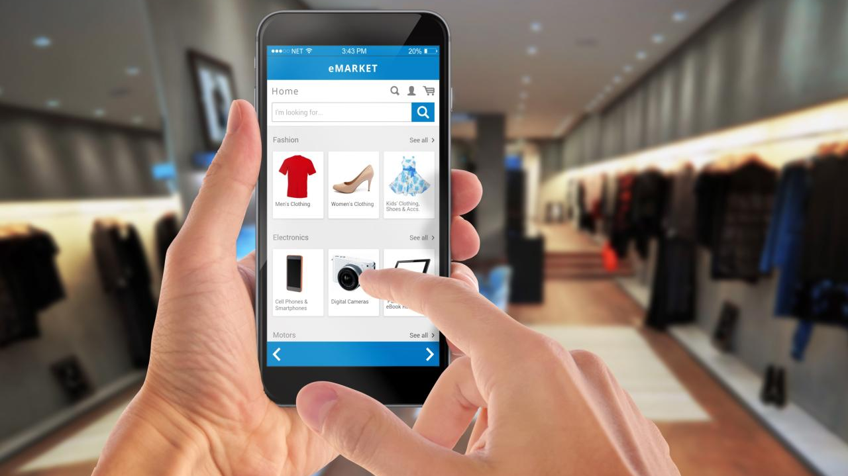
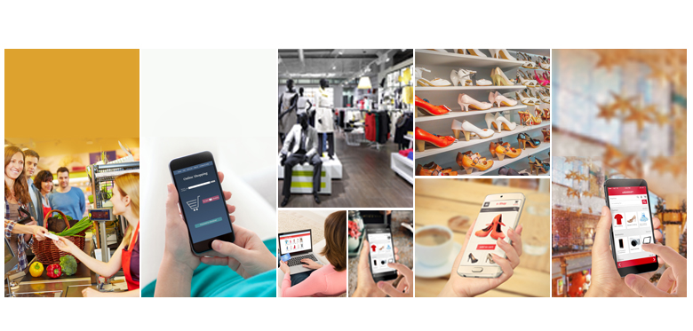
The Digital Retail Journey
Physical Store
Digital / eCOM
Multi Channel
Omnichannel
What is the future?
Brick & Mortar stores | Cash and Carry
Evolution of eCOM and mobile channels
Customers shopping at different channels – Brand Consistency
Focus from brand to customer – Consistent and convenient CX

Slide 6
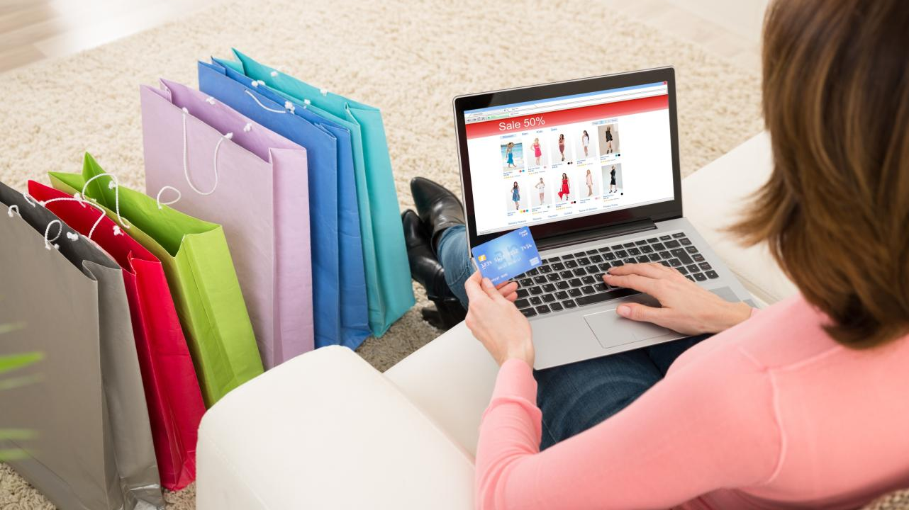
Today’s Omnichannel Experience
Marketing
CX
Payments
SEO
SEA
Behavioral Targeting
Convenience – Click and Pick, Click and return, Store inventory visibility, Same day delivery
Consistency – Pricing, Policies, Brand positioning
Apple Pay
Google Wallet
PayPal

Slide 7
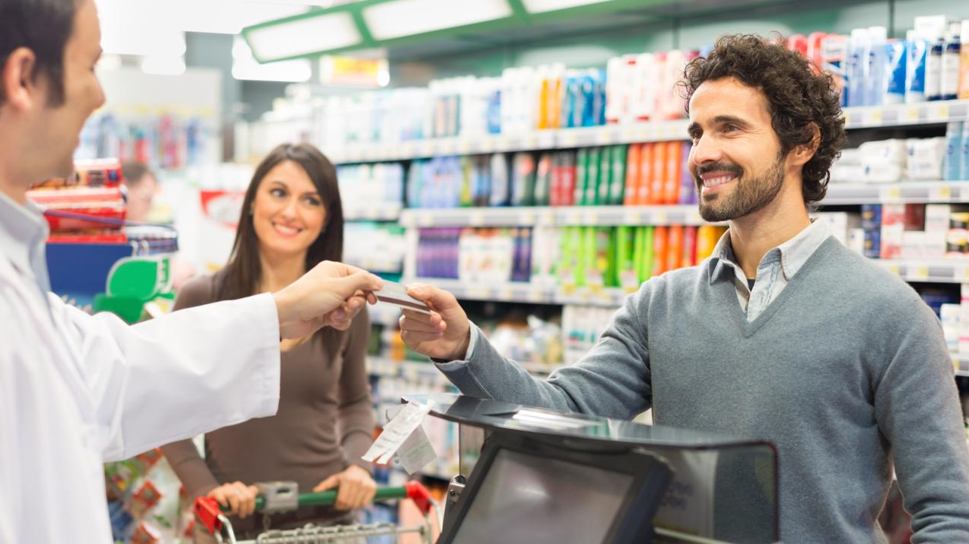
Results
As of 2015, 46 % of Argos’s sales are made over the Internet, and 34% of the retailer’s sales come from the Check & Reserve system.
01
Click-and-collect
now accounts for 45% of all John Lewis’s, a Department store in UK, online orders.
02
Shoppers who take advantage of the full Omni channel network tend to spend three times as much as people who are still using single channels for purchase
03
2.5% of Lowes Sales, $1.4 billion came from Online of which 60% are click and Pick, 30% are shipped from store
to Customer
04
Only 36,000 SKUs are available in an average LOWEs store where as their online assortment runs into 100s of thousands.
05

Slide 8
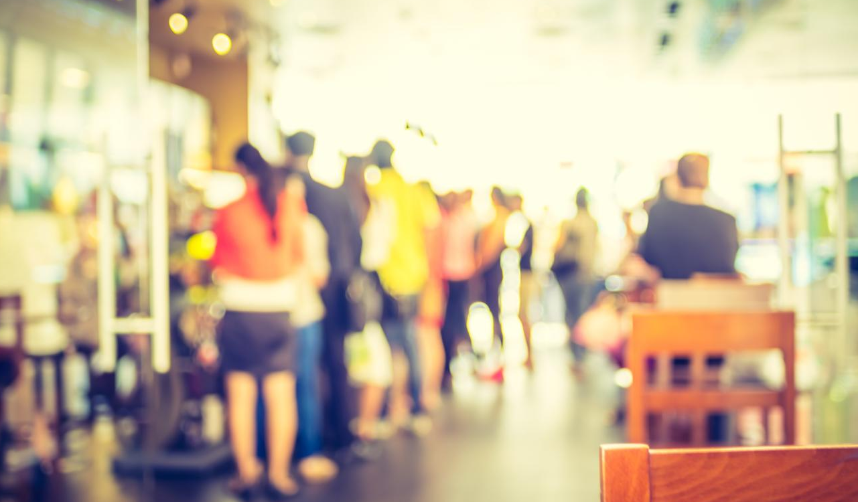
Are there Challenges?
Yes there are…
Right inventory visibility across channels…easier said than done
Order visibility – OMS implementations are long complex investments
Consistency in customer experience – UI to Associate training to pricing
But this is a natural maturity cycle…some are more mature than others

Slide 9
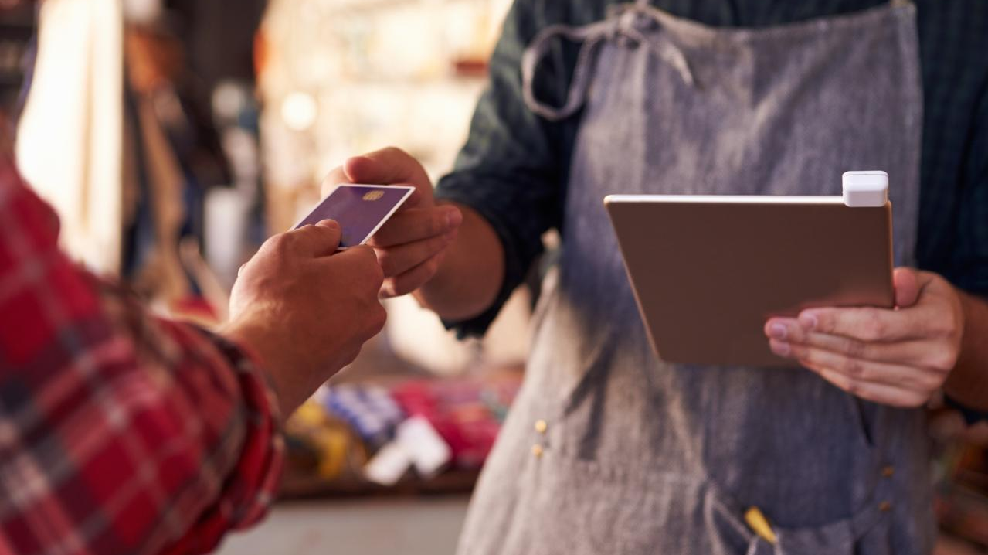
For us the question is different!
Is that it in retail journey? What are the next opportunities?
What is lacking in this Omnichannel model?
CX Opportunities
Technology Opportunities
CX Opportunities
CX Opportunities
Store experience is not enhanced much
Mobile in customers hand when in-store
Online and store journeys are independent – activity based jumping from one activity to other
Mobile in associate’s hand
IoT – Indoor Location knowledge, digital signage, virtual try-ons and mirrors
Digital and store marketing are not linked
Store manager incentives for encouraging customers for online / digital channels are not aligned
Big data – easy insights at low(er) cost
KPIs / Metrics for mutual / store impact is not well understood

Slide 10
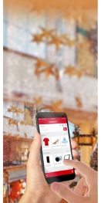
The Digital Retail Journey
Physical Store
Digital / eCOM
Multi Channel
Omnichannel
Phygital Retail
Brick & Mortar stores | Cash and Carry
Evolution of eCOM and mobile channels
Customers shopping at different channels – Brand Consistency
Focus from brand to customer – Consistent and convenient CX

Slide 11

What is it?
Phygital is Omnichannel 2.0
Phygital Retail–
Convergence of a consumers physical and digital world.

Slide 12

Four Trends that will shape tomorrow’s retail
Seamless movement between online and store : Instore CX via customer app
Self Service: Break queues, guided layout, virtual add-ons
Personalization: Right marketing at the right location at the right time
Empowered Employees: Customer insights and real time decision making

Slide 13

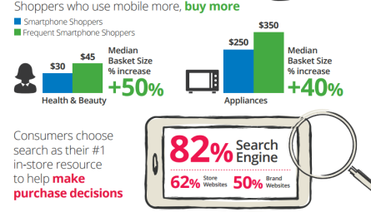
1. In Store Customer Engagement via Customer App
You are Consistent now you need to move across Channels seamlessly.
Mobile is kind of seamless glue that bridges Physical and Digital
“The big thing is not to think of mobile as just shopping on the go. Mobile is a tool for in-store.”
84%
of smartphone shoppers use their devices while in a store

Slide 14
1. In Store Customer Engagement via Customer App…cont.
Physical Store Shopping is a continuation of the online Shopping
Move wish lists and cart to store
Take the store interest out of store – size not available?
Physical Commerce
Online Commerce

Slide 15

2. Personalization – Be more relevant
Every Customer is Unique
Personalized Product Recommendations
Personalized Promotions
Location Based
Retailer knows you better

Slide 16
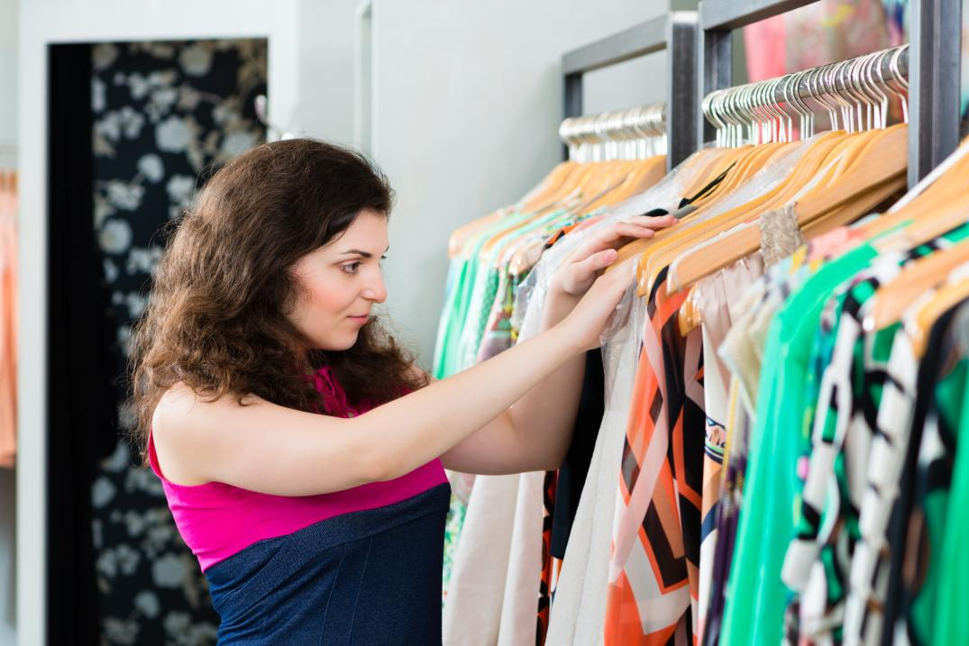
3. Self Service
Customers already use Smartphone while shopping, Retailers should follow
Customers do price comparison, share pictures with friends and family, pay using Digital Wallets.
Locate products in stores
Customers do not get the right help from the store associate “at the time of their need” – can your app do better?
Why stand in queue when you can pay by mobile?
1in3 shoppers use their smartphones to find information instead of asking store employees…
CAN YOUR APP DO BETTER HELP?

Slide 17

4. Empowered Employees
Store Associates are to be Empowered
Better Customer Insights
Better Product Insights
Easy Checkouts
Past transactions, feedbacks

Slide 18
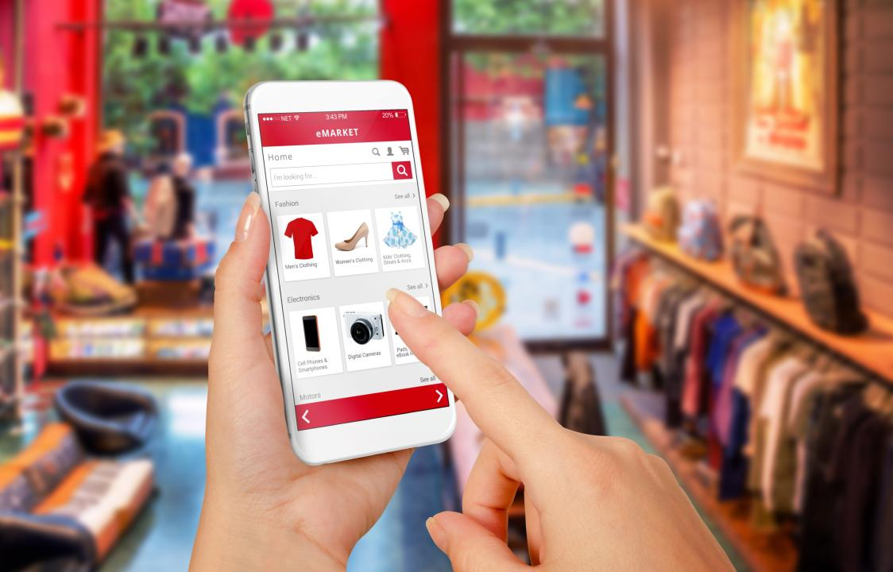
Is there One Solution that can help achieve Phygital Goals?

Slide 19
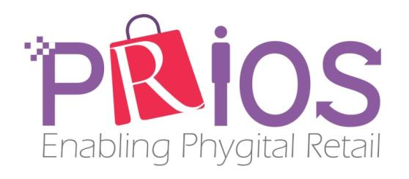
Aspire presents…PRIOS

Slide 20


Bringing
LATEST TECHNOLOGIES together

Slide 21
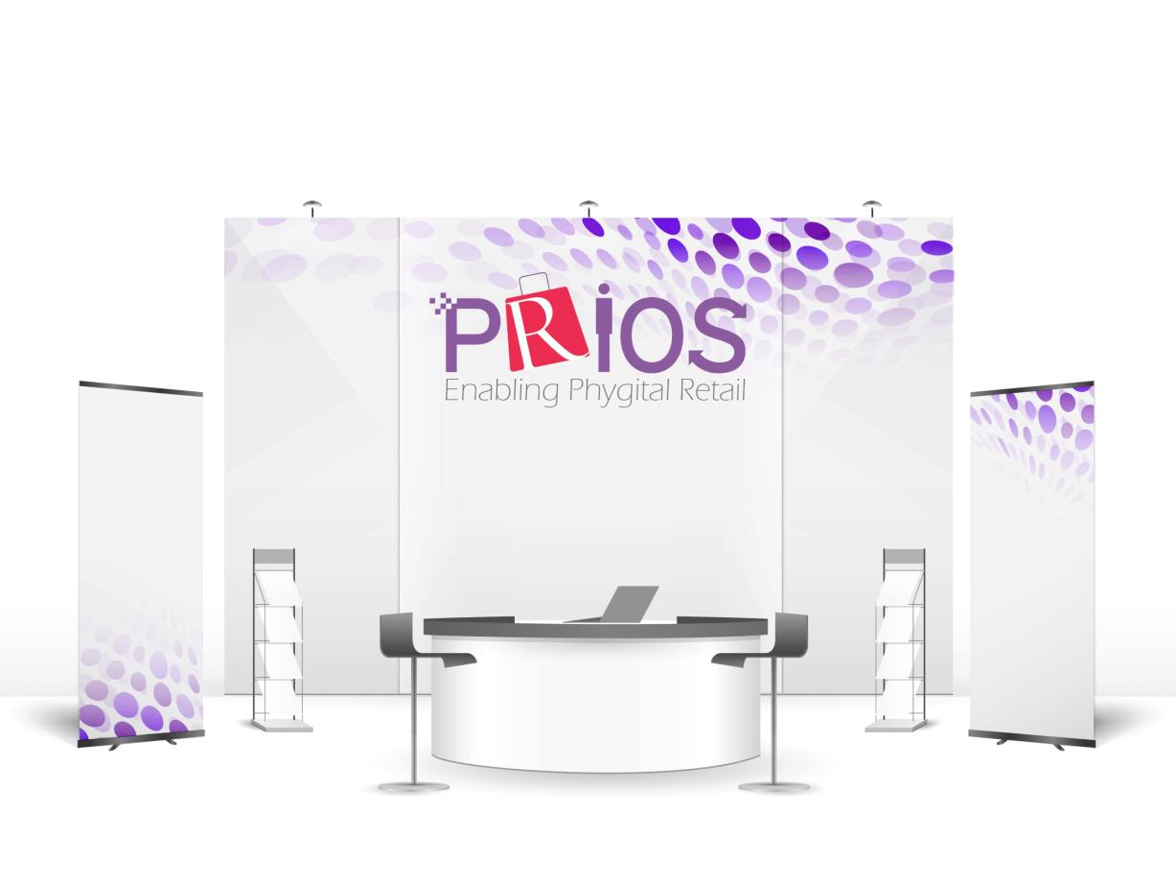
Meet us at Shop.org
Dallas, Texas
26th - 28th Sept
Booth: # 3095
For info contact:
sunil.bajaj@aspiresys.com
or
kamal.chandramohan@aspiresys.com

Slide 22
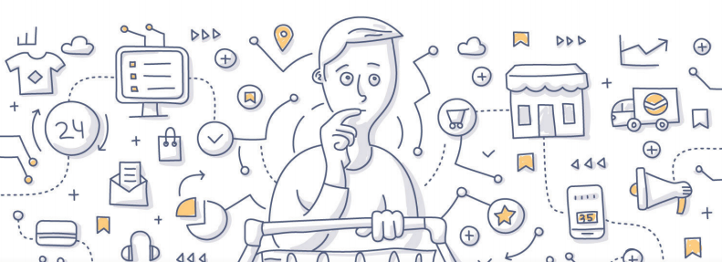
Q & A

