Slide 1
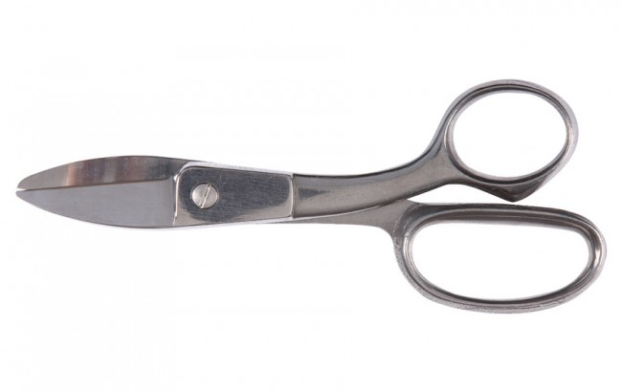
WOLFF Utility Shear image

