Slide 1
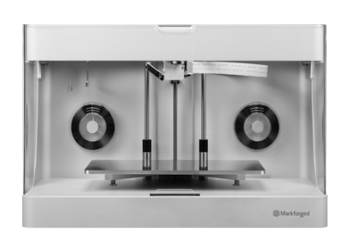
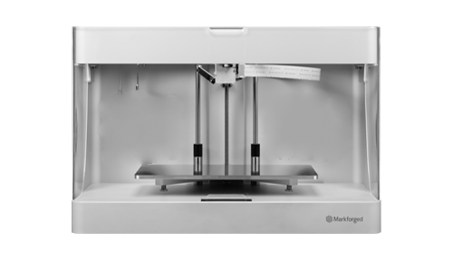
Strength comparison of materials across the Markforged line of printers, normalized to plastic. The Onyx Pro features Fiberglass and the Mark Two Enterprise printers feature Carbon Fiber for the strength of metal.
Mark Two Ent.
$13500
10X Strength
RELATIVE STRENGTH TO CONVENTIONAL PLASTIC 3D PRINTING
Onyx Pro
$6,999
5X Strength
Onyx One
$3,499
2X Strength
Notes:
Onyx is a big step up from other 3D printing plastics. Its tougher, stiffer, more heat tolerant, and more dimensionally stable. Compared to the competition we have broken the curve – now our entry point is 2x better at the same cost. The rest of the lineup then scales perfectly from there.

Slide 2
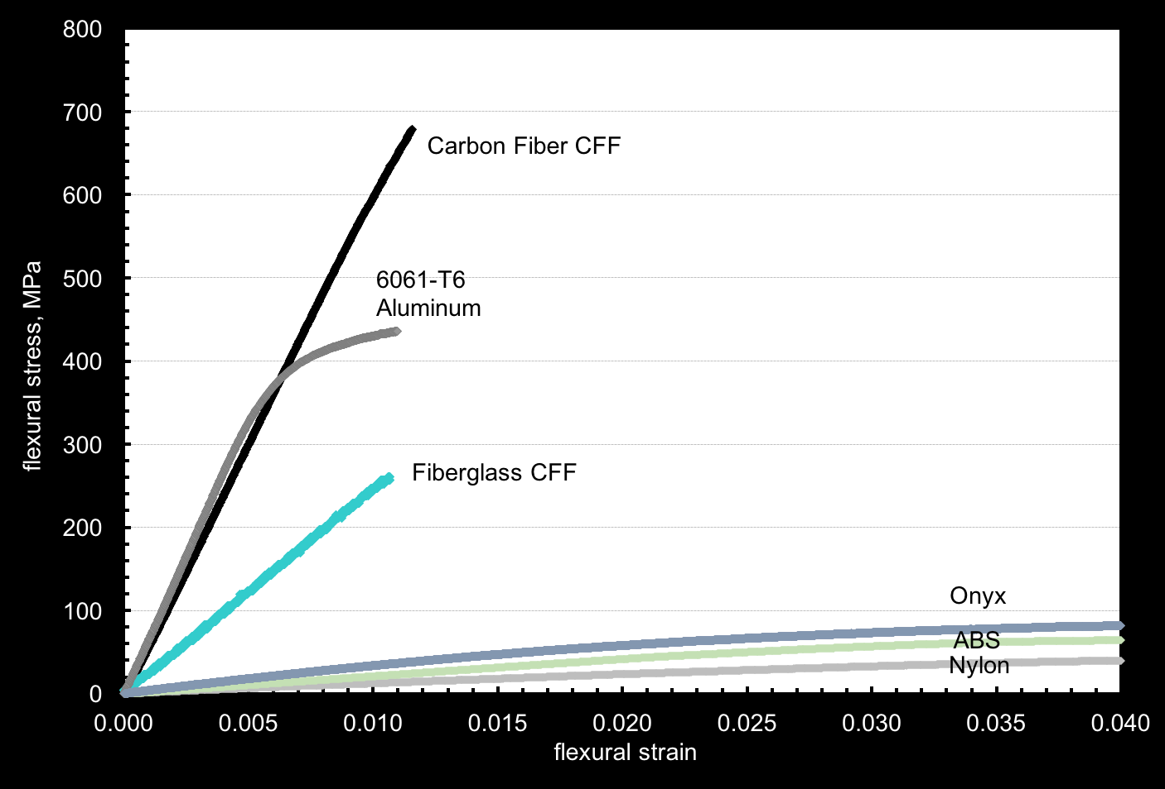
Strength curves of Markforged 3D printing materials
Notes:
Steep is stiff, high is strong

