Slide 1
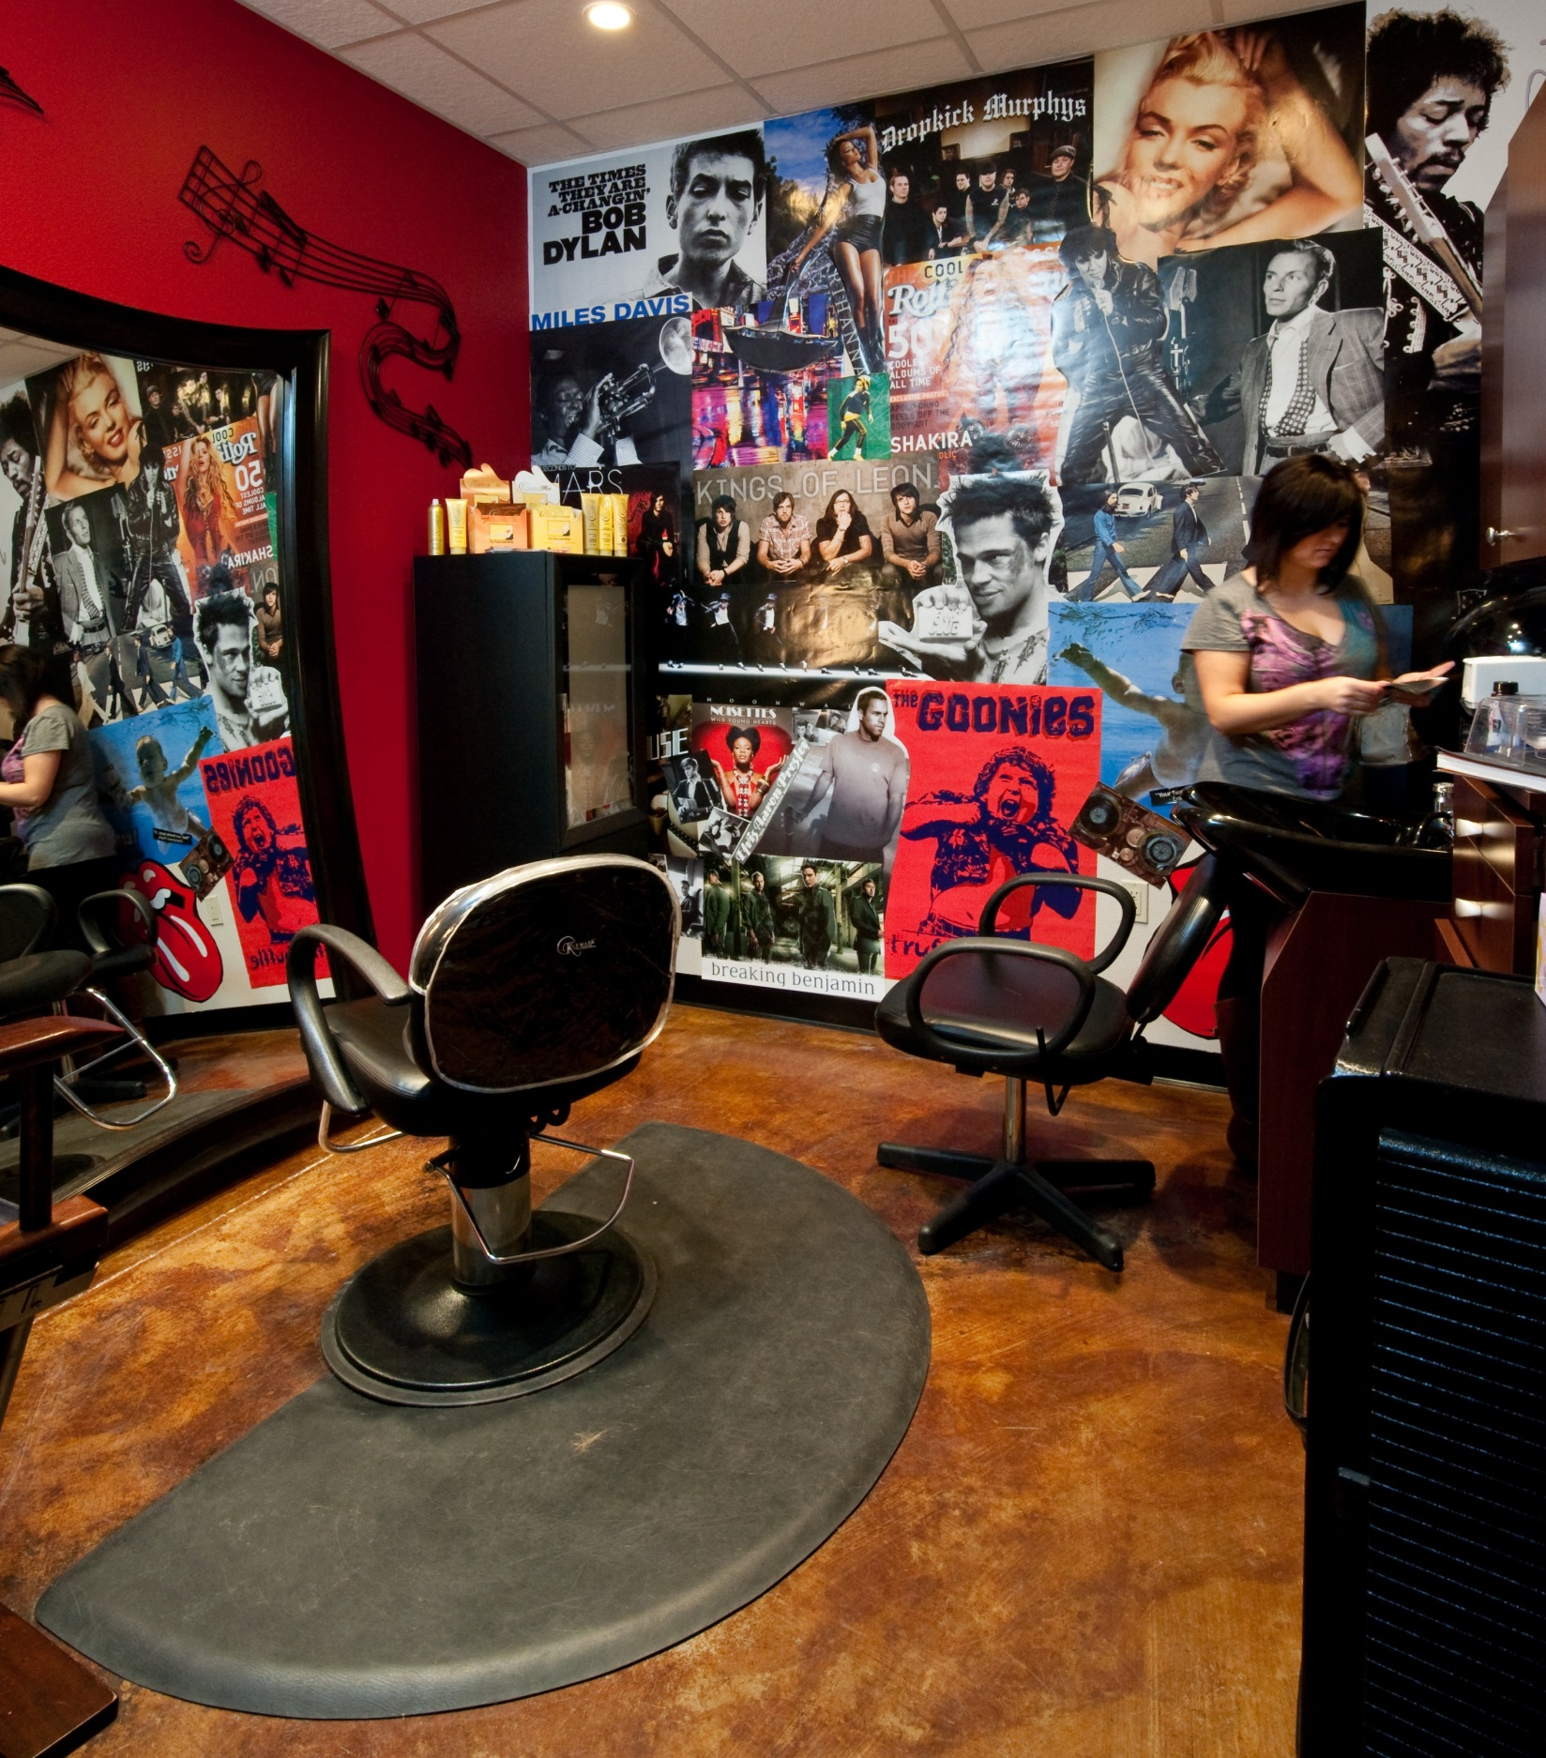
Investment Range
$260,000 (net of TI) for a single unit
Client Requirements
$250,000 Liquid, $750,000 net worth
Why Phenix Salon Suites?
Semi Absentee Model – 4-8 hours per week, manage 1 part time employee
Real Estate Selection - Huge TI assistance, develop more locations for less
Multiple Income Streams - Growing Phenix line of high end beauty products
Recession Resistant, No Seasonality - Hair never stops growing
Technology Resistant - Hair cannot be cut with an app
No Salon Experience Needed - All backgrounds are acceptable
Multiple Unit Development - Many of our licensees have over 5 locations
Third Party Financing Available - Reduces your out of pocket investment
Timeless, Up-Scale Design – Salon Professionals love it
Marketing Expertise – Phenix has proven methods to fill suites
National Branding – Phenix product line to be featured on Home Shopping Network this fall
What’s In It For You
Phenix Referral Fees
Single - $24,000
Multi- 40% of initial fee
High Closing Ratio!!!
Great Validation!!!
For more information:
Dennis Daughety
Director of Broker Relations
ddaughety@phenixsalonsuites.com
205-422-5661
www.phenixsalonsuites.com
www.phenixsalonsuitesfranchising.com
Gina Rivera, Founder of Phenix Salon Suites
The only salon company to ever be featured on Undercover Boss

