Slide 2
Value Proposition For Consumers
Personalized Coupons Auto-Deposited Into Consumer Account Coupons Redeemed Instantly at Checkout Auto-Combines All Store Promotions with CPG Coupons Maximizes Savings on Each Store Visit

Slide 3
Value Proposition For Retailers
Increased Basket Size Drives Revenue Increased Consumer Savings Drives Loyalty Eliminates Coupon Fraud & Chargebacks Reduces Total Coupon Scan Time to <300ms Rapid, Automated Electronic Reimbursement
*Source: Forrester Research

Slide 4
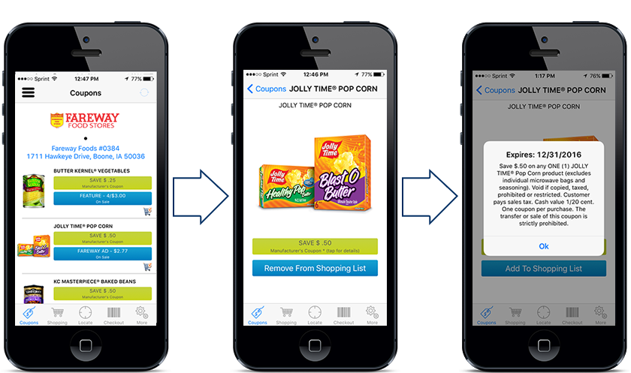
Invisipon Consumer Mobile App

Slide 5
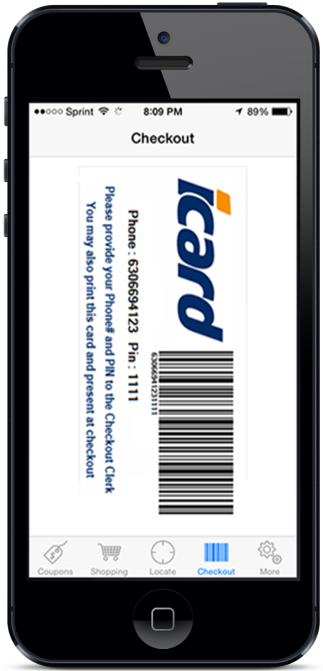
How To Redeem
Scan iCard directly from phone, or Swipe store loyalty card, or
Key phone number into POS, or Scan customer-printed iCard

Slide 6
Hundreds of CPG Brands And Growing Rapidly…

Slide 7
Summary

