Slide 1
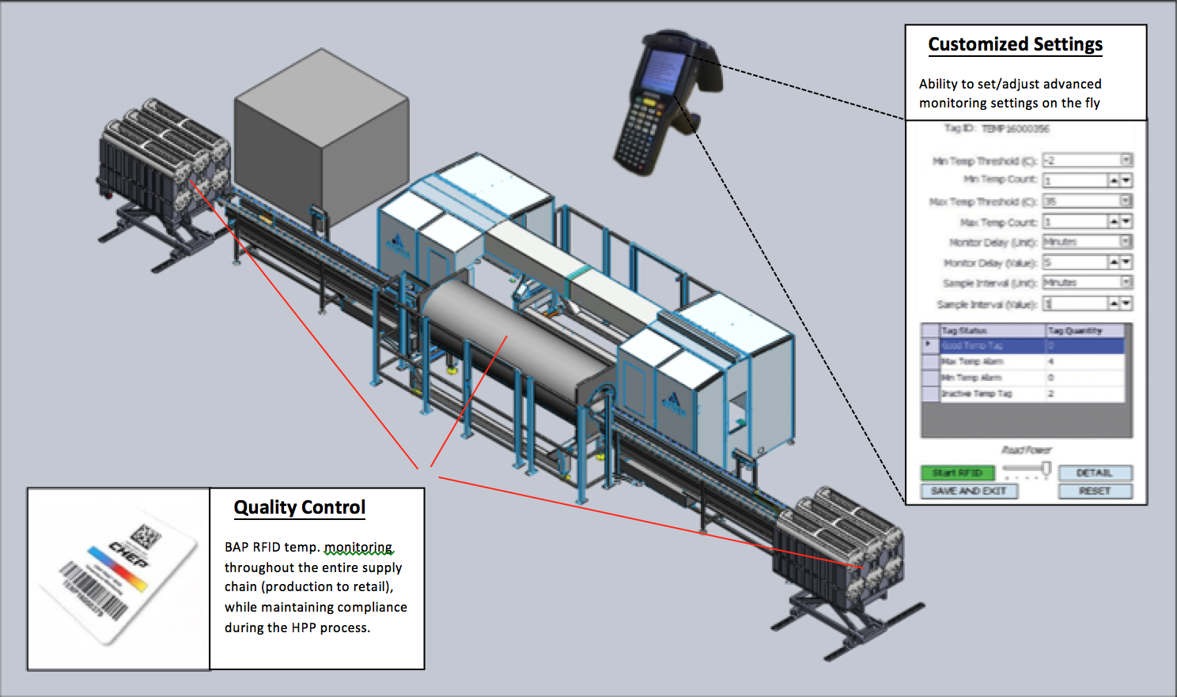
BAP RFID temperature monitoring customizable through HPP Processing

