Slide 1
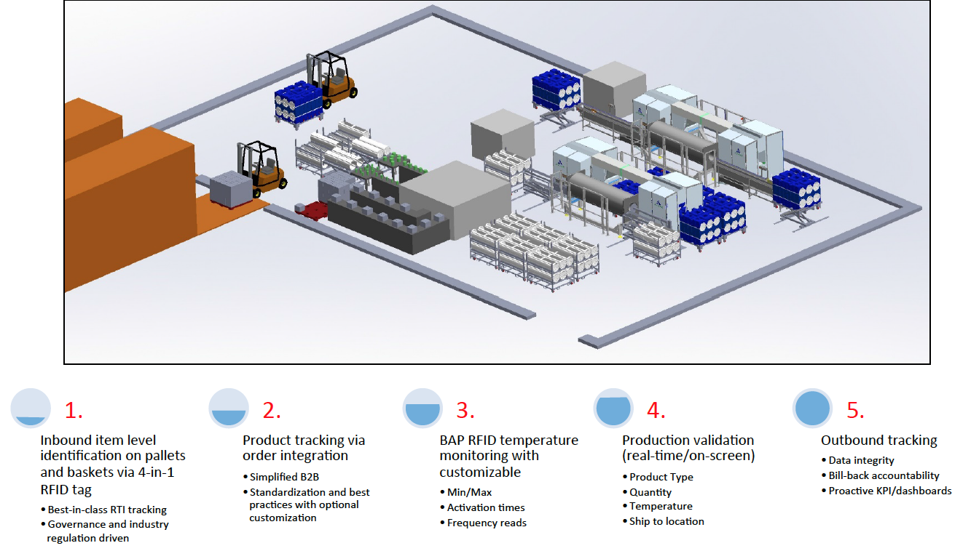
Track & Trace Powered By CHEP-TRACTM

