Slide 2
Purpose of BECS™ Bitcoin + Ethereum Crypto Summit
Pack 1-2 years of esoteric crypto knowledge into 6 hours
Paving the way for attendees to have a greater understanding of the blockchain and crypto ecosystem
Learn from experts in crypto and blockchain fields who are changing and defining it every day
Help crypto and blockchain businesses connect with the audience they wish to reach
To provide a no-frills national conference experience to a regional audience who may not have the resources or time to travel

Slide 3
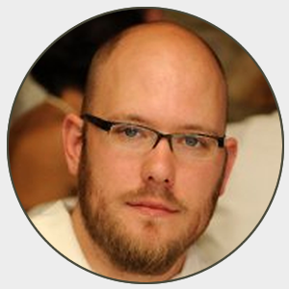
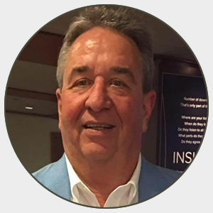
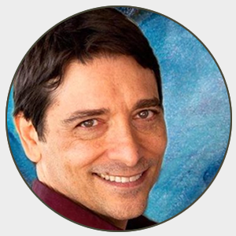
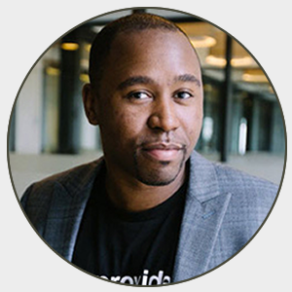
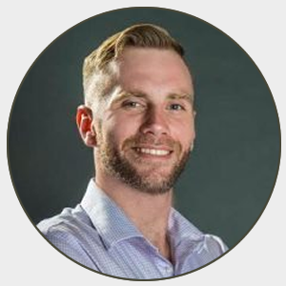
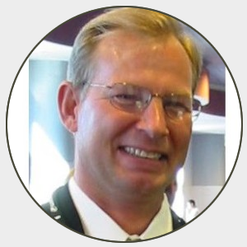
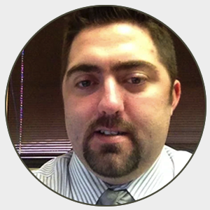
Competitive Lineup
Speakers include Cody Marx Bailey, James Drake, Brett Tabke, Rich Pasqua, Joshua Belland, Tony Cecala, Gary Leland, and many more
James Drake Embermine
Cody Marx Bailey
Gary Leland Crypto Cousins
Tony Cecala Crypto Cousins
Michael King Hip Hop Underground
Joshua Belland
Brett Tabke Pubcon
Casey Watkins Tokay
And more speakers are being added!

Slide 4
Sessions – more being added
Meet the Altcoins – Fast-paced review of over 20 of the top alternative cryptocurrencies, including Ripple, Stellar, Stratis, Monero, Dash, and many more
Cryptocurrency and Taxes
Overview of Cryptocurrency Exchanges such as Coinbase, Poloniex, and more
Cold Wallets, Hot Wallets, Paper Wallets, and more – The main types, how to use them, and keep your crypto safe!
How To Spend and Accept Bitcoin, Ethereum, and other Cryptocurrencies
The Basics of Blockchain and Internet of Money
Trading Bots and Trading Software
User Experience and the Blockchain
Mining 101 – What is it, how does it work, and should you start mining on your own?
How To Start Your Own Token or Coin
Understanding Coin Price Indexes

Slide 5
Get In…. While You Can – This Show is Going to Sell Out
Ticket Information – Register at EventBrite.com
Only 200 tickets available
25 Super Early Bird tickets available
100 Early Bird tickets

Slide 6
Why Sponsor Bitcoin + Ethereum Crypto Summit?
The name of our conference says it all. Influential crypto voices descend on Dallas for one reason: to hear the unique educational content from some of the best minds in the crypto space.
Reach a core audience of people interested in learning about the crypto space

Slide 7
Sponsor Kit
BECS | Advertising Sponsorship Program
 | Title Sponsorship 1 Available | Session Sponsor (10 available) | Exhibitor/Table Sponsor (10 available) | Lanyard/ Sponsor | Tshirt Sponsor 1 available | Beverage Sponsor | Physical Token Sponsorship – 1,000 Minted
Price Per Show | $10,000 | $500 | $1,500 | $3,500 | $6,000 | $2,500 | $3,500
Logo with link on BECS™ website | X | X | X | X | X | X | X
3 minute intro prior to afternoon keynote | X
Table in Exhibit area | X |  | X
Marquee Title Sponsor Mentions- Social, press releases, etc. | X
Announcement as session sponsor before one session |  | X
Logo on Lanyard Holders |  |  |  | X
Logo on reverse of conference T-Shirt, 200 shirts |  |  |  |  | X
Physical Token – One side BECS, the other side your company |  |  |  |  |  |  | X
Logo banner above conference drink tables |  |  |  |  |  | X

Slide 8
Contact Us
www.bigcryptosummit.com
Rob Garner 469.347.4090 rgarner1@gmail.com

