Slide 1
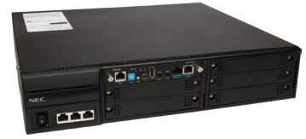
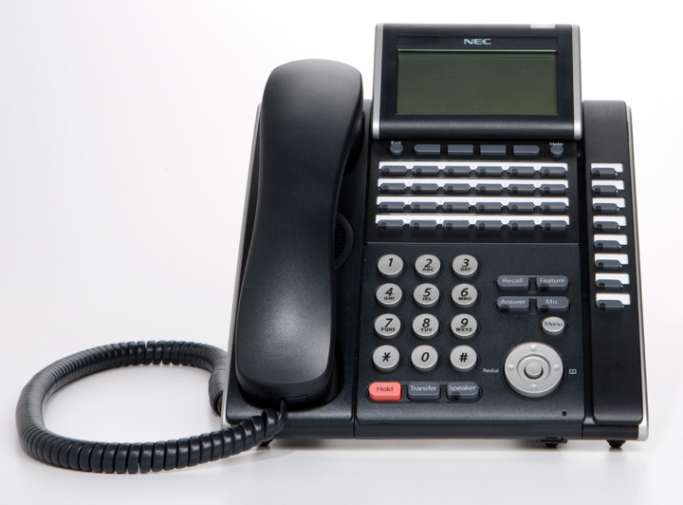
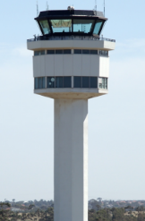
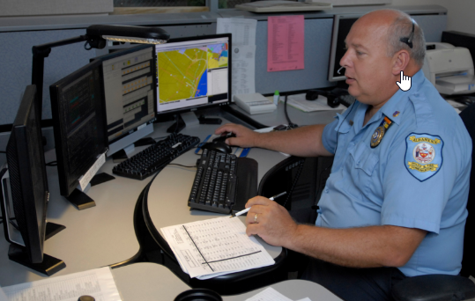
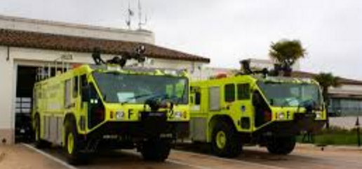
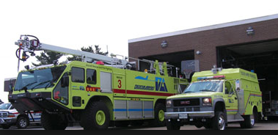
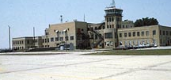
IP Based Crash Phone Deployment
Off Hook at ATC triggers the Ring down Firebar Conference with a predetermined group of people.
2
1
Pilot informs ATC
of trouble
Fiber
Ring Network
Redundant
RFCS
Initiator Phone
3
As people go off-hook they are joined into a multi-party audio conference
ATC Tower
ECC 911 Dispatch
Fire Station
West
Fire Station
East
Airport Admin
Building

