Slide 1
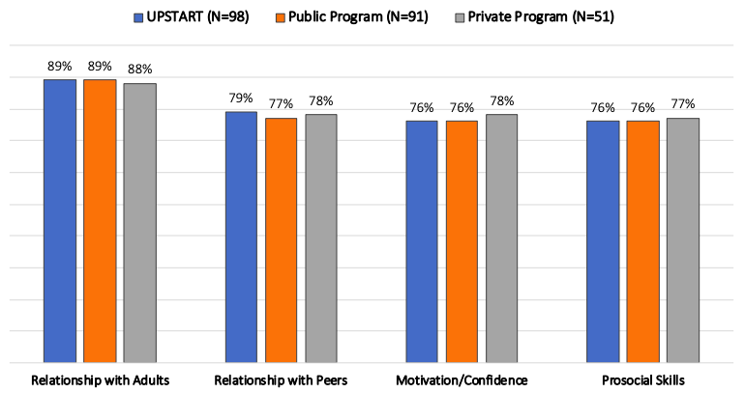
UPSTART – Social Emotional Learning (SEL)
UPSTART was recently evaluated as part of Utah’s High-Quality School Readiness (HQSR) Grant. A review of social emotional development skills by program group showed comparable social-emotional development for UPSTART when compared to both public and private preschool programs.

