Slide 1
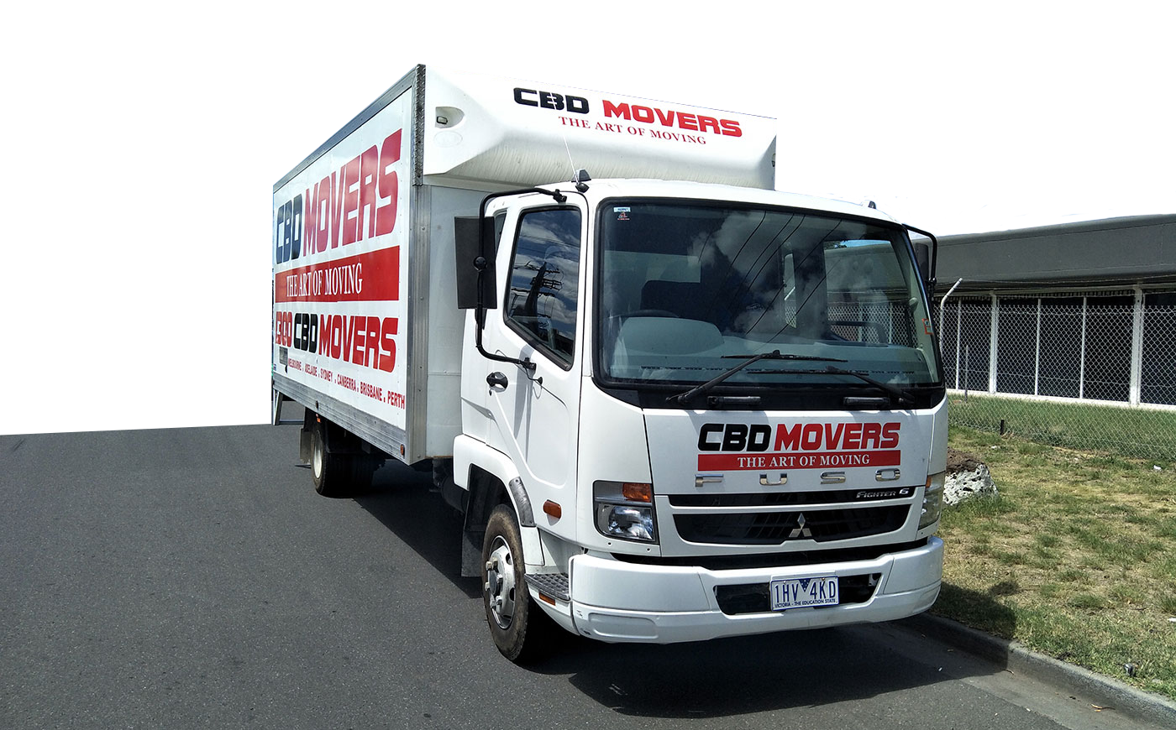
CBD Movers is a trusted company in Australia, expert in moving any kind of house, office and commercial furniture safely.

Slide 2
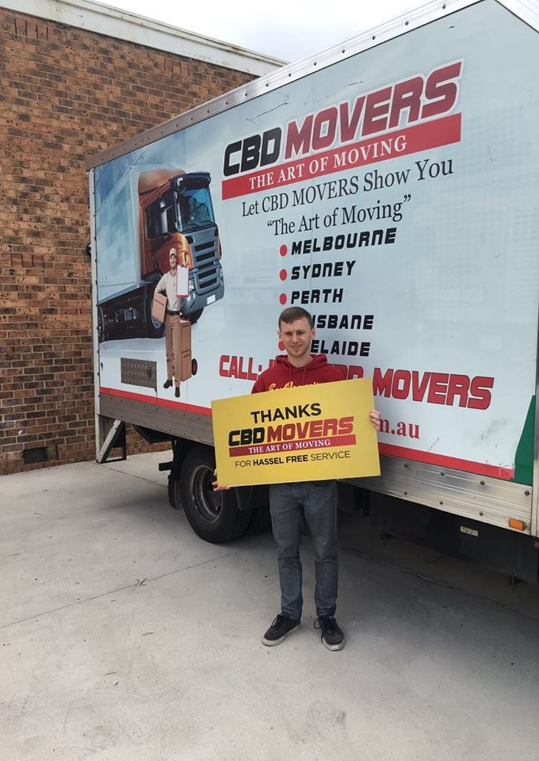
WHY CBD MOVERS
Obligation Free Quotes
Highly Skilled Removalists
Save Your Time and Money
Charge Low Hourly Rate
All Size of Trucks are Available
Local & Interstate Movers

Slide 3
CBD MOVERS SERVICES
CBD Movers provide services like:
House Removals
Office Relocation
Interstate Delivery
Piano Movers
Pool Table Movers
Furniture Moving
Loading & Unloading

Slide 4
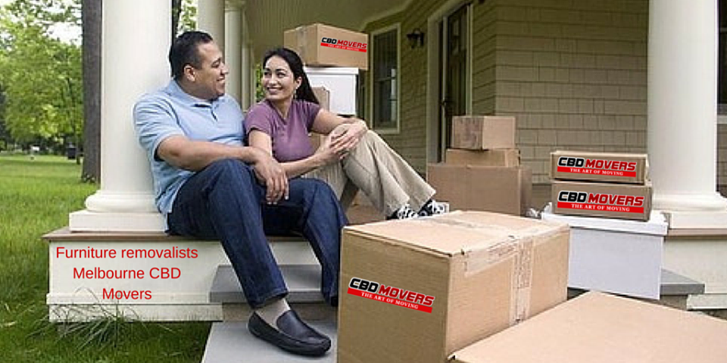
HOUSE REMOVAL SERVICES
CBD Movers provide house removal services in Australia including Melbourne, Perth, Brisbane. They have experts which help you to plan, organize, pack and deliver all your delicate antique items, furniture to the new location safely.

Slide 5
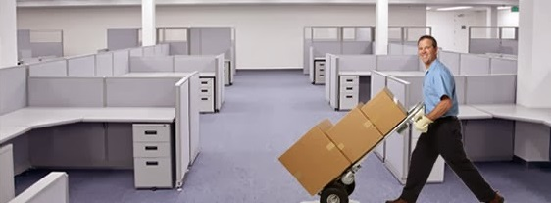
OFFICE RELOCATION SERVICES
“CBD Movers” professional removalists are experienced in packing and handling of all kinds of important equipment like PCs, servers and furniture. They use proper moving equipment like moving pads, trolleys, packing boxes, etc for safe office relocations.

Slide 6
PIANO MOVING SERVICES
Moving Piano is a quite difficult job for anyone without a help of moving professionals. “CBD Movers” company experts provide successful piano removal services in Melbourne and its surrounding areas.

Slide 7
POOL TABLE MOVING SERVICES
Pool table requires lots of care and maintenance at home, then how can CBD Movers professionals ignore this important thing while moving pool table to another place. They are specialists in pool table packing, maintenance, loading and unloading.

Slide 8
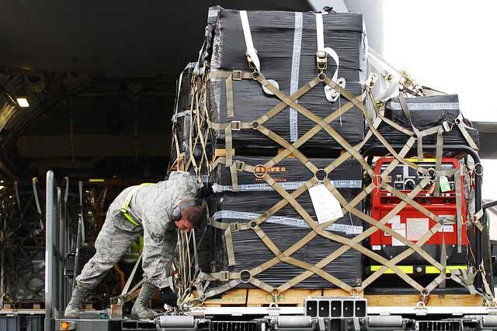
LOADING & UNLOADING
CBD Movers staff is fully trained in using loading and unloading equipments to move any type of furniture like household, office or commercial . They deliver all items safely, on time, to another places through trucks and vans.

Slide 9
CONTACT CBD MOVERS
Call at 1300 223 668 for budget deals!!
OR
VISIT HERE www.cbdmovers.com.au

