Slide 1
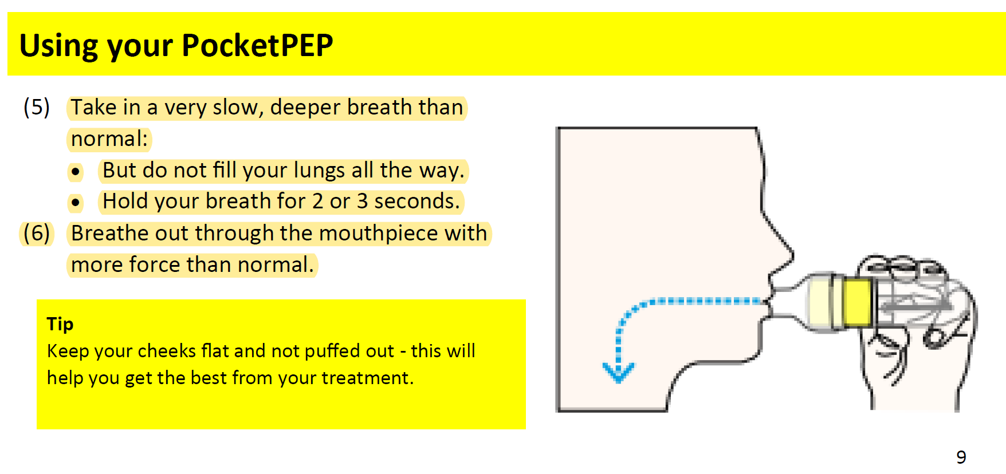
D•R Burton PocketPEP simple instructions for use
Easily performed by most patients

