Slide 1
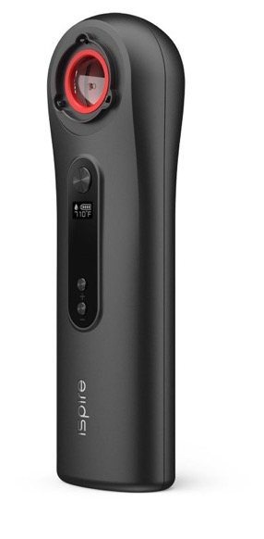
The Wand
Dabbing Without Fire
Welcome to the dabbing revolution. Our sleek portable eNail dab kit includes the first ever eNail to use induction heating. It gives you the power to select your desired temperature for the perfect dabbing experience every time.
With The Wand, you're in control.
The Wand combined with our Borosilicate glass bangers create a safe and easy dabbing experience by eliminating the need for a torch along with the wires and coils found with other eNails. By using borosilicate glass bangers with an induction heating method, The Wand is able to precisely heat the banger to your desired temperature. Once it is at the perfect dabbing temperature place the concentrate in one of our borosilicate glass bangers and take the perfect hit.
000
Product Features
￭ Induction Heating
￭ Quartz Banger Cups
￭ Battery
￭ Viscosity Ranges
￭ Temperature Settings
￭ Safety Features
￭ Compatibility

Slide 2
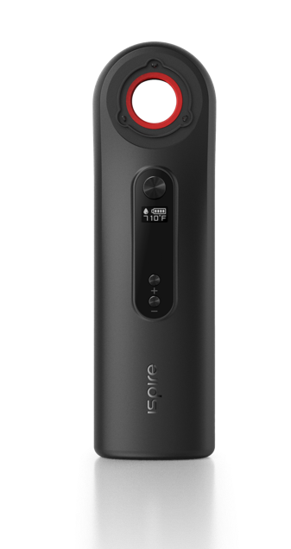
Induction Heating Patented Technology
Dabbing Without Fire
What makes this heating method so unique? In most common heating methods, a torch or open flame is applied directly to the part to be heated. With induction heating, heat is “induced” within the part itself by circulating electrical currents. Since heat is transferred the part never comes into direct contact with any flame or contaminant, the inductor itself does not get hot and there is no product contamination. When properly set up, the process becomes very repeatable, controllable, clean and safe.

Slide 3
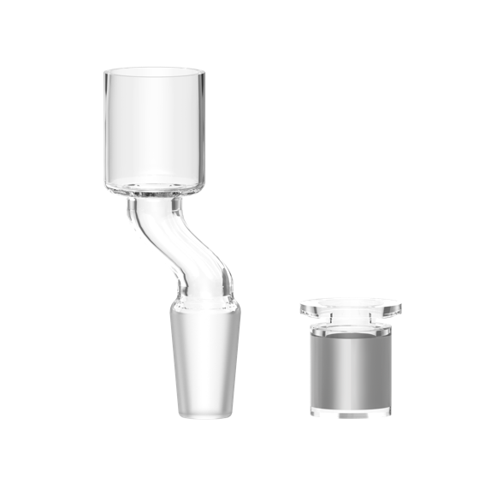
Borosilicate Glass Banger Cups
Ispire Patent Pending
Our Borosilicate Glass Banger cups have ferrous metal encased in between two sealed walls of Quartz completely sealed away from the dabbing environment and creating an absolutely clean and sealed Quartz Banger cup.

Slide 4
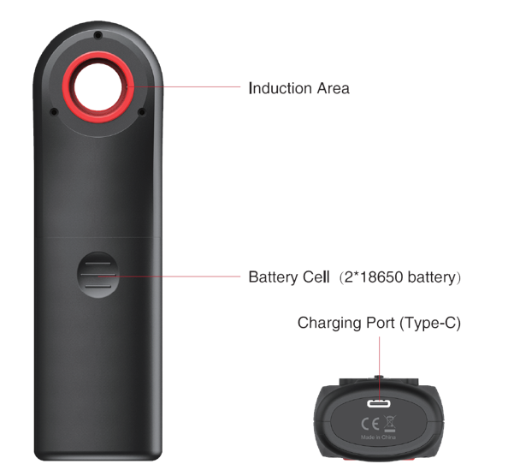
Dual battery 18650 cell
USB Charging Available
The Wand induction device uses replaceable dual 18650 battery to power the super high heating efficiency with minimal combustion. Moreover, external batteries ensure extended usage for a worry-free experience. Rechargeable via USB port – fast charging, the Wand device can reach up to 5 Volts with a maximum charging current of 2 Amps.

Slide 5
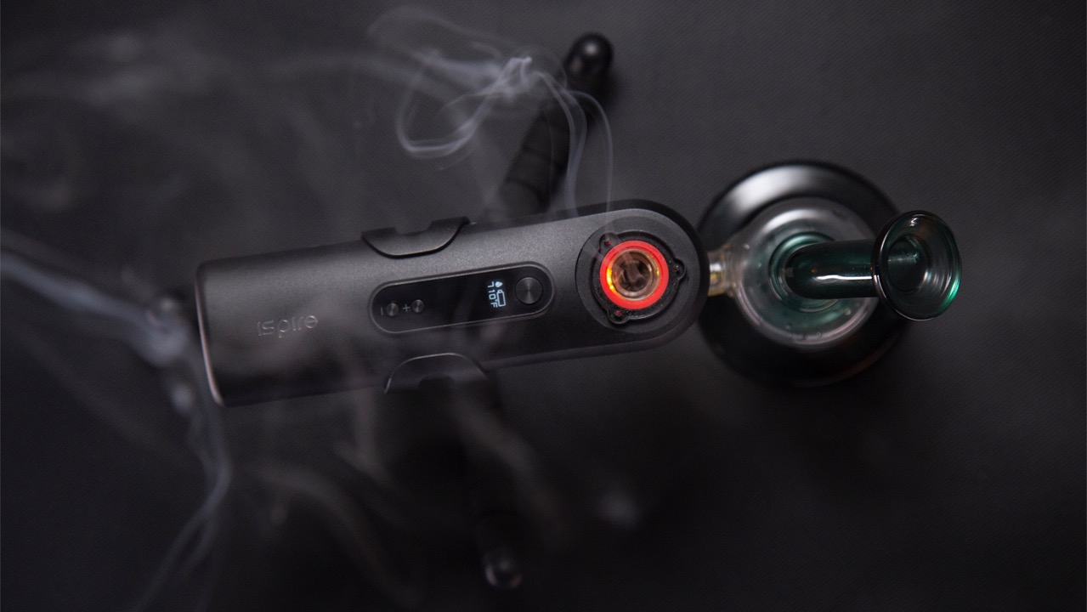
All Viscocity 18650 cell
Wax and Concentrates
Versatile enough to support wax and concentrates of any viscocity to meet your daily preference

Slide 6
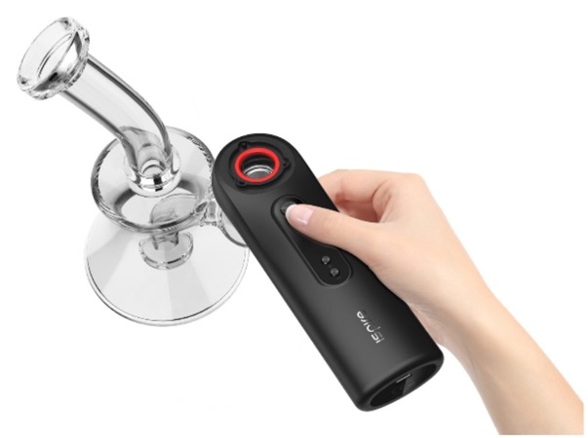
Precise Temperature settings
Auto and Manual Mode Available
With accurate temperature control settings, it easy to adjust temperature control settings for that perfect dabbing experience. The Wand also available in both Auto and Manual mode for more flexibility.

Slide 7
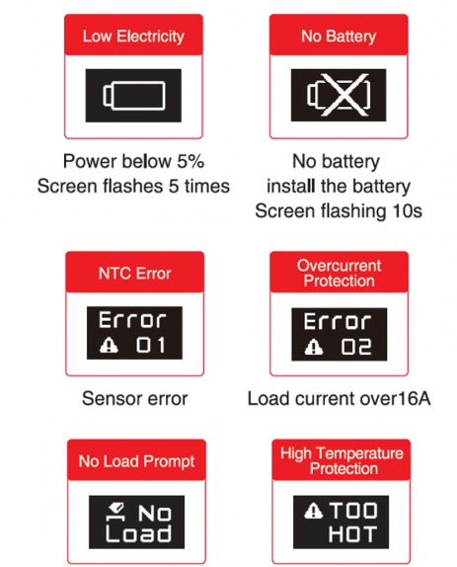
Safety Features Industry Standards
Built for convenience
Equipped with industry standards safety features to ensure top performance, durability, and prolong usage.

Slide 8
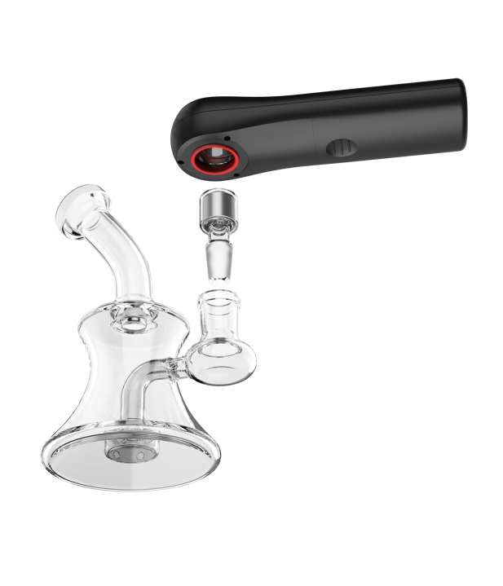
Cost-Effective Compatible accessories
Suitable for personal use
Super compatible with most bongs on the market, the wand comes accessorized with both angled and straight bangers. A cost-effective and safer alternative to the traditional oil rigs, it is compact and suitable for personal use.

Slide 9
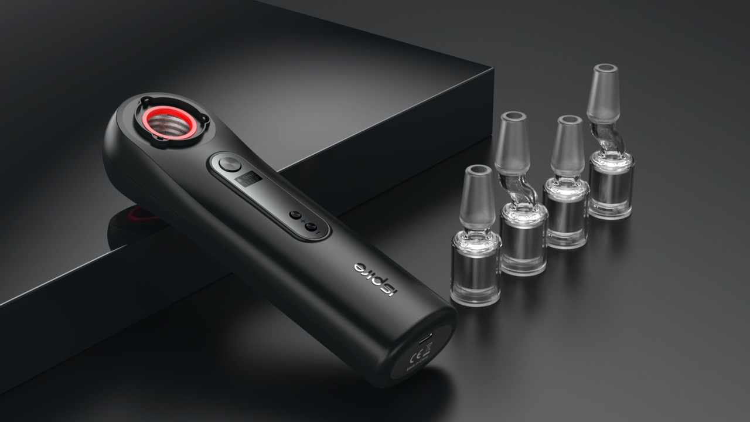
Available for Wholesale

Slide 10
Technical Specs
Activation Mode
Manual and Auto Mode
Software
Upgradeable Software
Temperature Range
450 to 800ºF
Battery Capacity
External Dual 18650
Charging Current
5V – 2A
Liquid Temp Range
Optimal at 710ºF
Charging Port
Micro USB / Type C Cable
Accessories
Borosilicate Glass Banger Cups

Slide 11
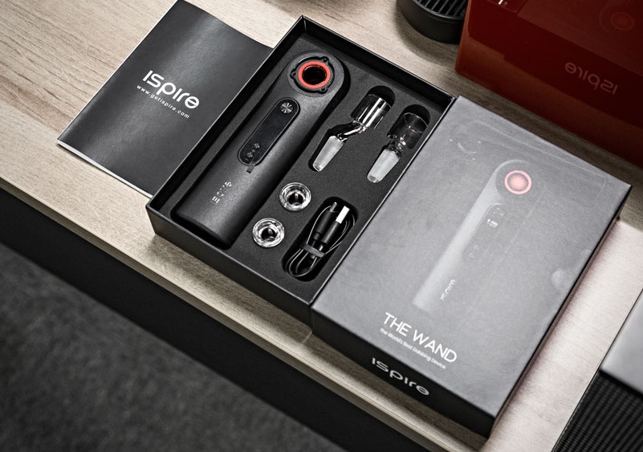
In the Box
The Wand Kit Box comes with
The Wand Device x 1
Charger Cable x 1
Straight Banger x 1
Angled Banger x 1
Inner Cup x 1
User Manual x 1
**External Battery not included

Slide 12
sales@getispire.com
marketing@getispire.com
www.getispire.com

