Slide 1
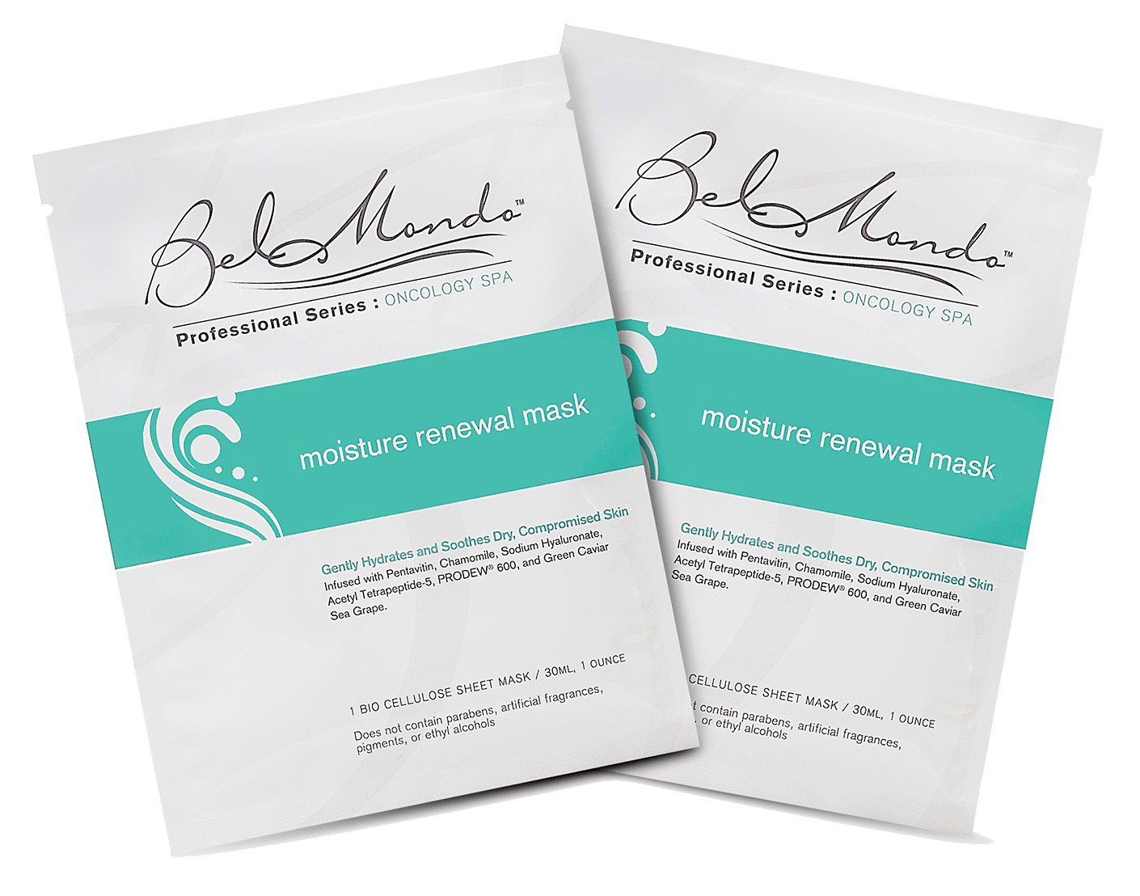
Bel Mondo Beauty
Moisture Renewal Mask
For Oncology Spa Services

Slide 2
Bel Mondo Beauty: Our Niche
First US brand to develop and market facial and body treatment masks made exclusively from an advanced fiber called bio cellulose.
Sales channels: spas, medical spas, spa distributors, and aesthetic device manufacturers.

Slide 3
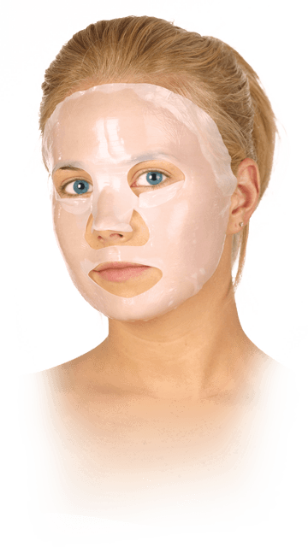
Bio Cellulose: The Ultimate Mask Fabric
Incredible Affinity to Skin
3-Dimensional Trench Structure (Woven Fabric)
Extremely Occlusive: Adheres Like Second Skin
Transfers Ingredients Efficiently
Cool, Soothing Texture

Slide 4
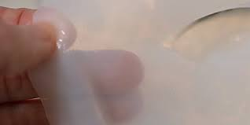
Bio Cellulose: The Ultimate Mask Fabric
Resilient, Durable Fibers (Tensile Strength)
Produced from Microbial Culture, Not Mass Manufactured
Fluid-Holding Capacity 100 Times Dry Weight
Biocompatible With Skin (Initially Developed for Medical Application)

Slide 5
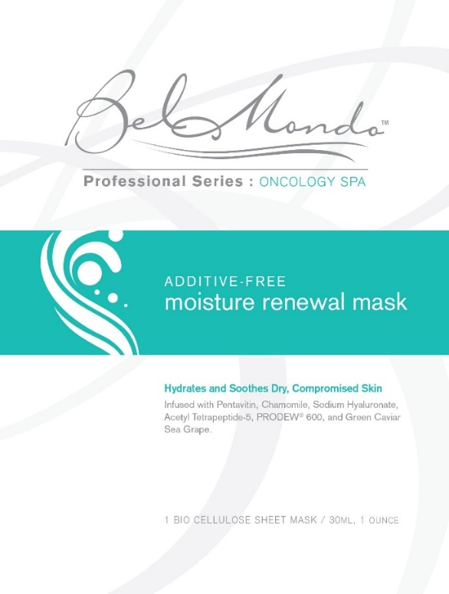
market direction: professional series with targeted applications
Initial Product
Moisture Renewal Mask for Oncology Spa Services

Slide 6
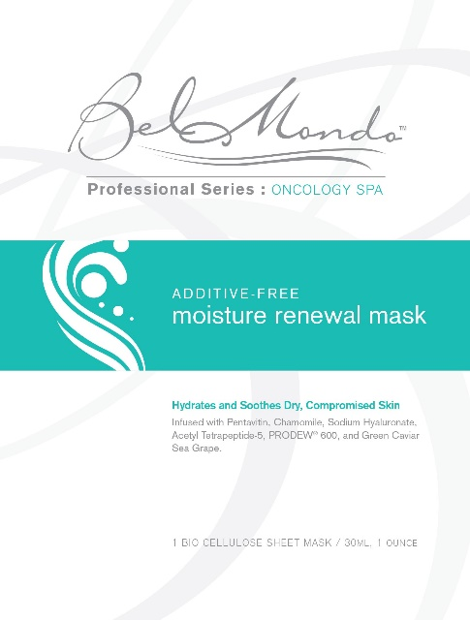
market direction: professional series with targeted applications
Bel Mondo’s Moisture Renewal Mask was developed in collaboration with Oncology Spa Solutions, a leading educator for training spa professionals to care for clients experiencing cancer and the side effects of treatments.

Slide 7
Moisture Renewal Mask: key properties
Occlusive Fabric With Cool, Soothing Texture
“Free-From” Formulation (Eliminates Potential Irritants)
Excellent Hydrating and Skin-Conditioning Ingredients

Slide 8
Moisture Renewal Mask: key properties
Free-From :
Bel Mondo’s Moisture Renewal Mask is free from major classes of additives that can potentially irritate compromised skin. These include artificial fragrances, pigments, ethyl alcohols, paraben preservatives, silicon and petroleum-based surfactants, and mineral oils.

Slide 9
Moisture Renewal Mask: key benefit
Alleviates adverse side effects to skin associated with cancer-care therapies:
Extreme dryness
Redness, sensitivity, inflammation
Itching, peeling

Slide 10
Moisture Renewal Mask: key Active ingredients
Pentavitin
Chamomile (ECO-CERT)
Sodium Hyaluronate
Acetyl Tetrapeptide-5
Green Caviar Sea Grape
PRODEW 600

Slide 11
Ingredient functions
Pentavitin (Saccharide Isomerate)
Binds to keratin, regulates and retains moisture
Anti-irritant

Slide 12
Ingredient functions
Chamomile (Chamomilla Recutita Matricaria)
ECO-CERT (Organic Certification)
Anti-irritant, soothing agent
Recommended choice for sensitive skin

Slide 13
Ingredient functions
Sodium Hyaluronate
Salt form of hyaluronic acid (greater compatibility with skin)
Skin-replenishment (boosts moisture content)
Antioxidant properties

Slide 14
Ingredient functions
Acetyl Tetrapeptide-5 (Peptide)
Enhances elasticity, smoothness
Hydrates and calms

Slide 15
Ingredient functions
Green Caviar Sea Grape (Caulerpa Lentillifera Extract)
Rich in amino acids (building blocks for healthy skin)
Aids moisture absorption
Helps maintain elasticity

Slide 16
Ingredient functions
PRODEW 600
Humectant blend, derived from amino acids
Excellent moisture absorption and retention properties
Mimics components of the skin’s NMF (Natural Moisturizing Factor)

Slide 17
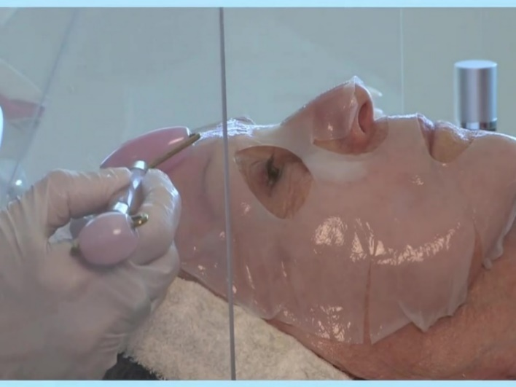
Incorporated into 2021 training protocol developed by founder of oncology spa solutions
“Angel Kiss Facial”
https://www.youtube.com/watch?v=HUzr3EOIgqE

Slide 18
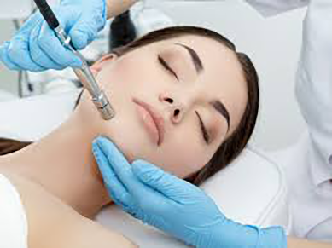
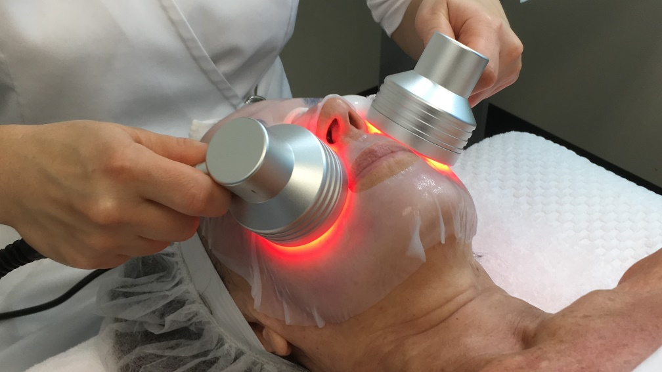
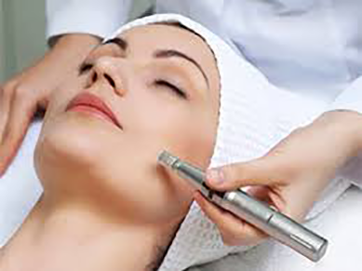
Secondary useage: THE Safety profile and soothing formula OF BEL MONDO’S MOISTURE RENEWAL Mask PERMIT IT TO BE A SMART ADD-ON TO COMMON aesthetic services

Slide 19
www.belmondobeauty.com

